Slide 1


Ecole d’Eté 2014
Altimétrie spatiale
Sea State Bias
N. Tran, L. Amarouche, P. Dubois, S. Labroue (CLS)
D. Vandemark (UNH)
Ecole d’Eté 2014, Saint-Pierre d’Oléron, 1-5 septembre 2014

Slide 2
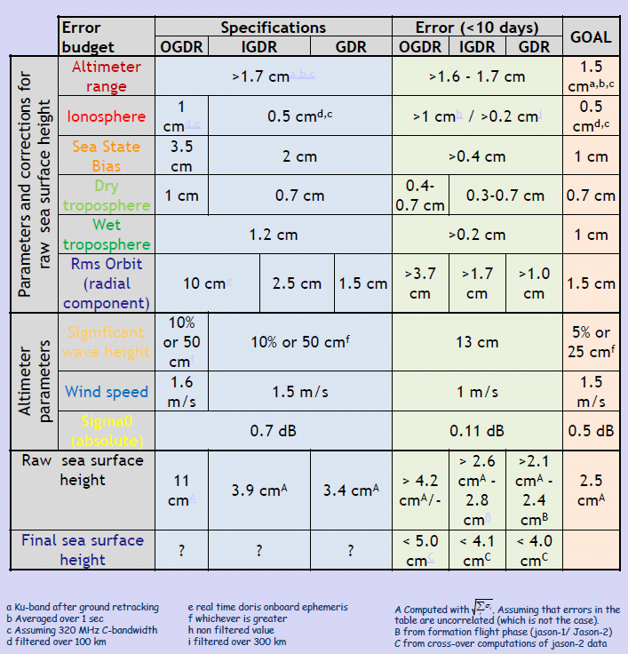
Introduction
Global Jason-2 error budget for time-scales < 10 days
From (http://www.aviso.oceanobs.com/fileadmin/documents/OSTST/2012/Philipps_jason2_global_error.pdf)

Slide 3

Contents
Origin and issues of the modelling of the sea state bias
Calibration of the geophysical parameters and empirical models
Frequency dependence and ionosphérique correction

Slide 4
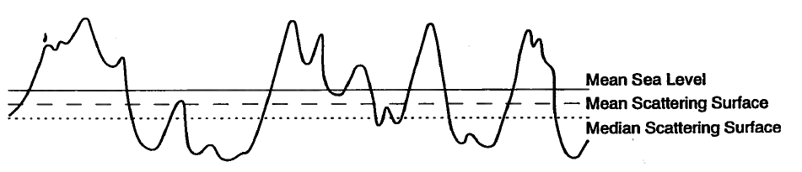
What do we mean by “sea state bias” ?
Ocean surface waves induce a range bias in altimeter retrieved sea surface height (SSH), because “real” waves have peaky crests and flat troughs along with non-uniform distribution of surface rugosities
This error or Sea State Bias (SSB) has to be modeled and removed for accurate altimetry measurement.
It includes:
SSB = Electromagnetic Bias + Skewness Bias + Processing Bias
Due to:
Hydrodynamic modulation : correlation of short waves slopes with long waves heigths
Tilt modulation : correlation of long waves slopes with long waves heights
They lead to:
wave troughs are better radar reflectors than crests at nadir
mean scattering level below mean sea level (bias towards troughs)
Due to:
Long waves height third order moment
They lead to:
median scattering level below mean scattering level (bias towards troughs again)
Due to:
Any other bias not related directly to the surface but displaying geographical correlations with the sea state
They lead to:
Additional errors

Slide 5
Theoretical evaluation
The SSB can be then expressed as the mean of the sea surface heights ponderated by sigma0.
Using a two-scale scheme, the mean backscatter can be expressed as:
σ0 depends on ξ => Hydrodynamic modulation
Long waves heights and slopes are correlated => Tilt Modulation Bias
Higher order moment on ξ ditribution => Skewness Bias

Slide 6
Limitations and usefullness of theoretical solutions
There is no reliable theoretical model for SSB available for operational use despite numerous efforts because:
such model depends on sea surface parameters not measured by altimeter (spectral peak period, spectral width parameter, peak amplitude, fetch, wave age, …) and unavailable from numerical wave model
such parameters are required everywhere to support point-by-point SSB correction
there is insufficient observational information on the space and time characteristics of the non-linear sea surface at the wave scales that are involved in the sea state bias
However, theoretical activities on SSB using simulation tools are helpful to evaluate new instrument concepts such as for example: SAR Doppler and wide swath interferometric altimeters, in terms of scientific requirements fulfillment from anticipated knowledge of the SSB behavior

Slide 7
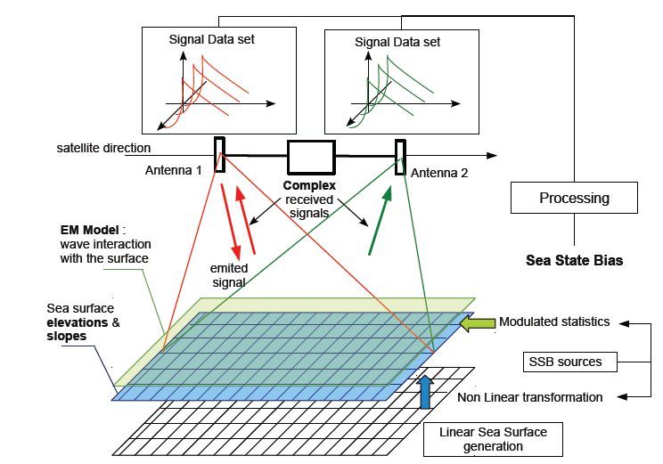
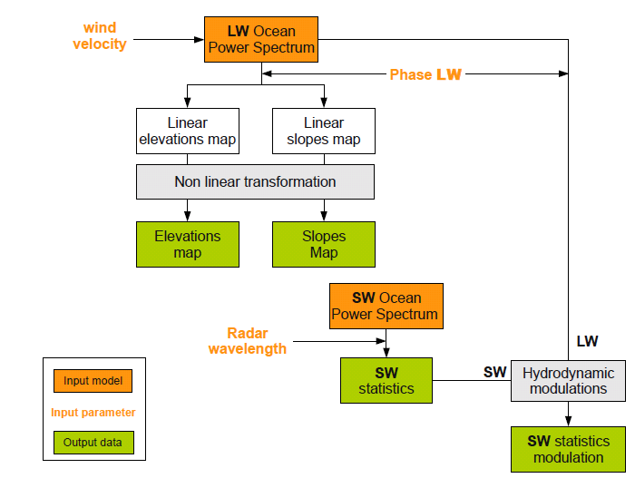
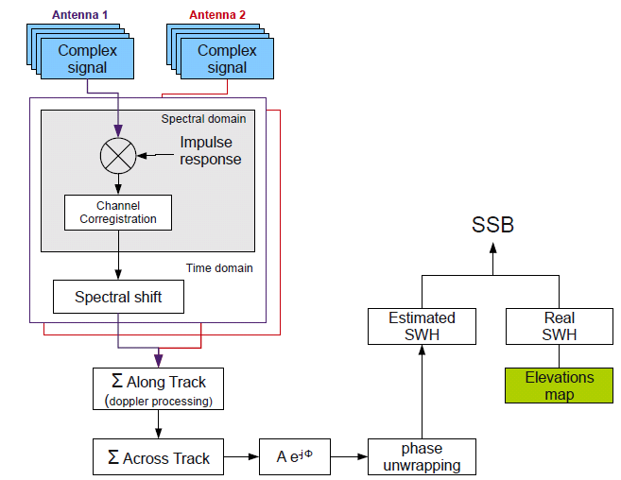
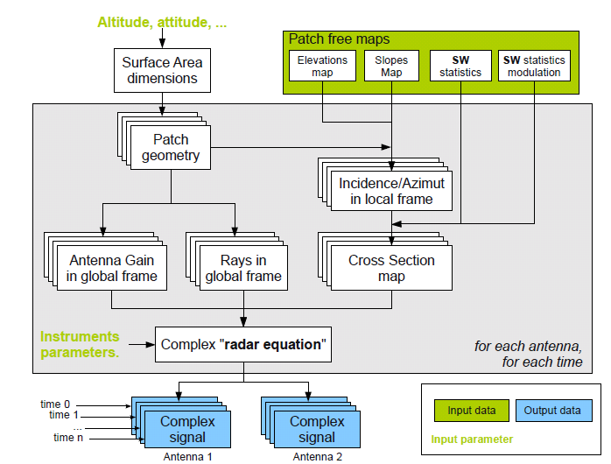
Simulations principles for SWOT (for example)
surface module
Instrument module
Processing module

Slide 8
Empirical determination
Accurate SSB correction is critically important for ocean circulation: it may introduce systematic regional errors in Mean Sea Level linked to wind/wave climate
To date, SSB operational correction models are developed using empirical relationships between repeat pass altimeter sea surface height (SSH) measurement differences, wind speed (U), and significant wave height (SWH) measurements
Use of time difference (3-10 days) of SSH uncorrected for SSB, SWH and U and a large dataset to cancel/average out all other effects and leave out the SSB residual (signal part correlated with SWH and U variations)
ΔSSH (cm) = ΔSSB + σ → SSB (X) ≈ 1-5% SWH
X = (SWH, U)
0

Slide 9
Issues and error sources in solving for SSB
Fitting SSB to SWH and U commonly
X imposed by pragmatic choice / availability
Inherent dependence between range, SWH, U from retracking of waveforms
Stability and quality of input SWH and U are first-order issues
Statistical methods for solving SSB
Polynomials models (3 or 4 terms) – limitation to reproduce the dependences on X
Non-parametric solutions (NP: linear local kernel, splines)
Geophysical error due to choice of X
wave age, long wave slope variance, mean period, swell height, ...
Does σ tend to 0?
this error term holds correction terms such as orbits, HF barotropic, ionosphere, tides, ...
potentially geographically correlated errors with sea state
tested when new version available to check impact on SSB solution
Lack of independent ground truth for error estimation and validation
performances evaluated in term of variance reduction
Some illustrations in next slides

Slide 10
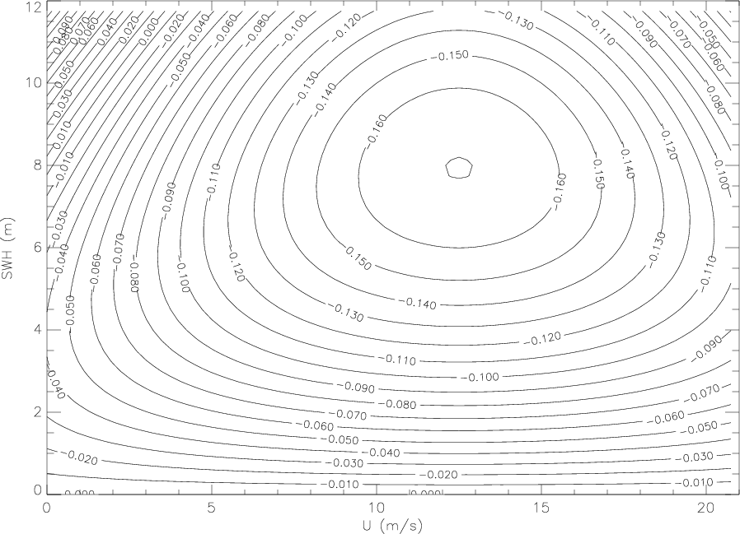
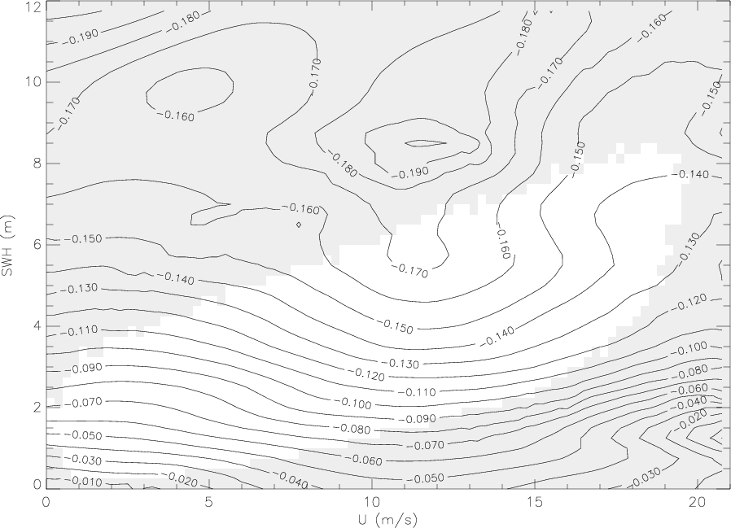
Parametric vs Non-Parametric (NP) models
TOPEX BM4 (from Gaspar et al. 1994)
a*SWH + b*SWH*U + c*SWH*U2 = d*SWH²
TOPEX NP

Slide 11
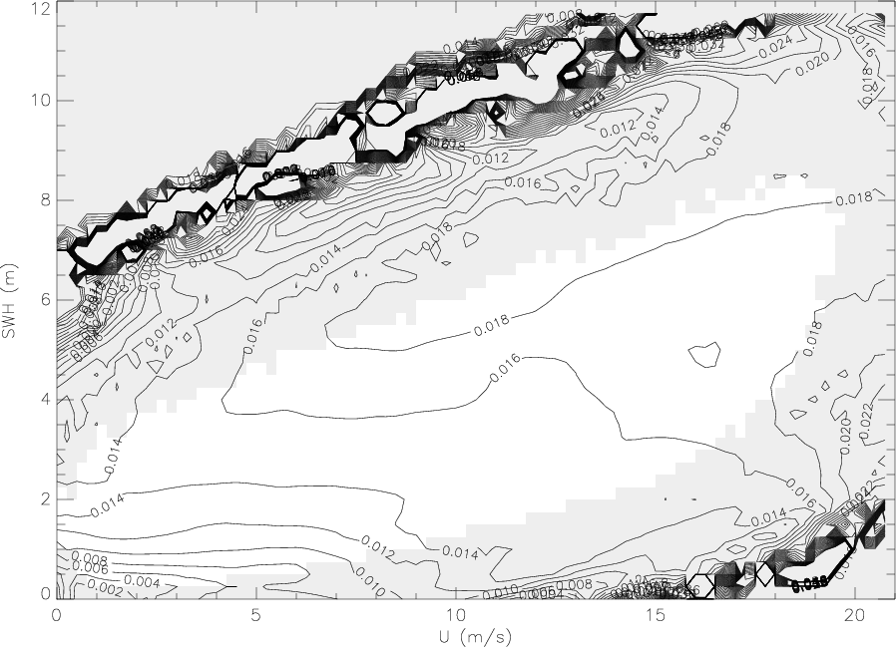
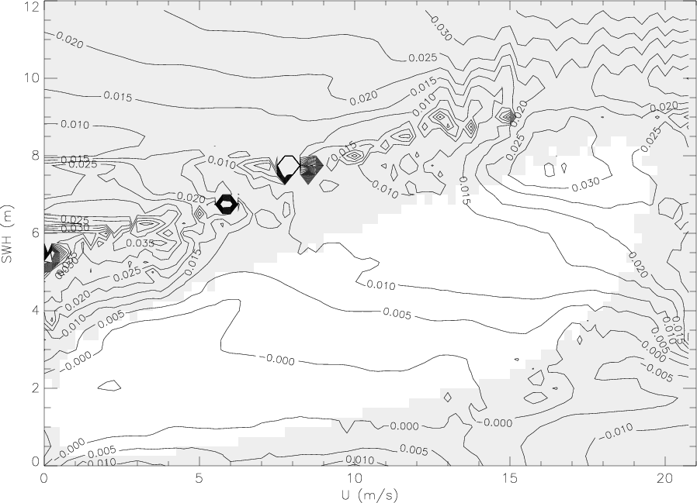
SSH data accuracy – Impact on SSB
Envisat SSB difference, (ESOC – GDR) orbits
Jason-1 SSB difference, (MOG2D – IB) corrections

Slide 12
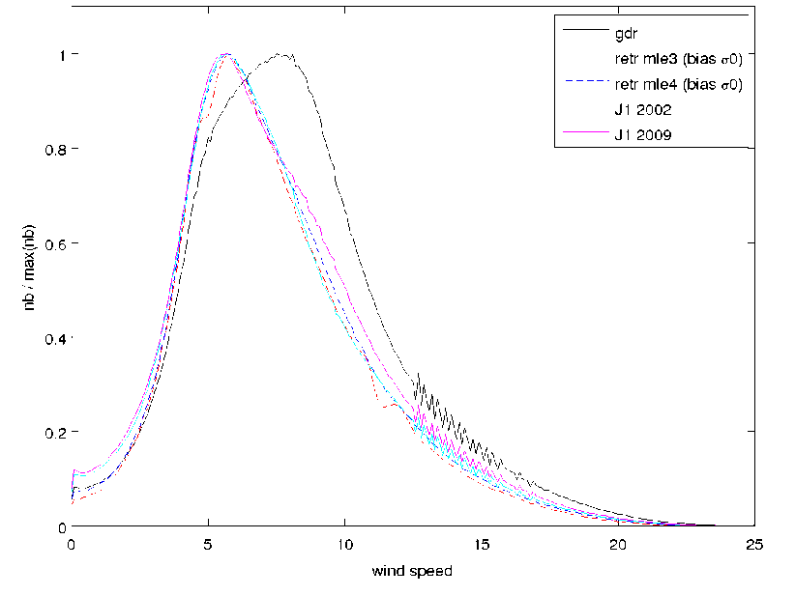
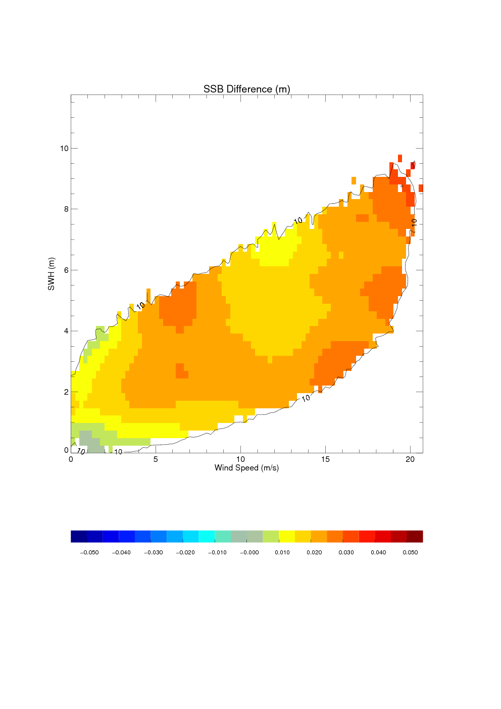
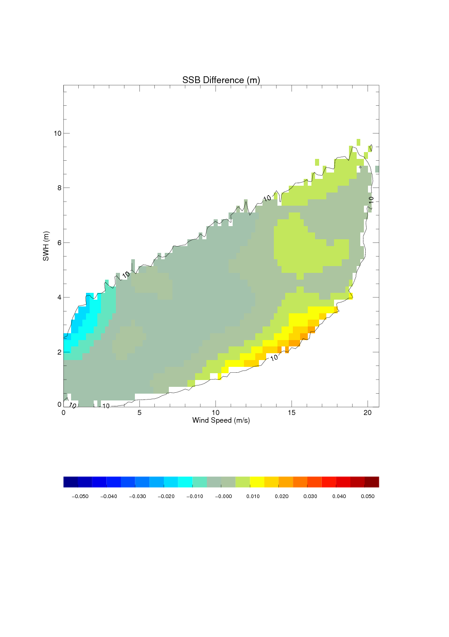
Wind speed calibration
If we want to compare models, we need to work in the same reference frame (SWH, wind speed)
SSB_J2_Ref – SSB_J1_Ref
Diff of estimation approach
Diff of data version
Diff of wind speed distribution
+15
SSB_J2_U_MLE4 - SSB_J1_Ref
Diff of estimation approach
Diff of data version
Similar wind speed histogram
+5
+25
-5
+20
[-5, +5 mm]
+20
+5
- 50 mm
+ 50 mm
- 50 mm
+ 50 mm

Slide 13
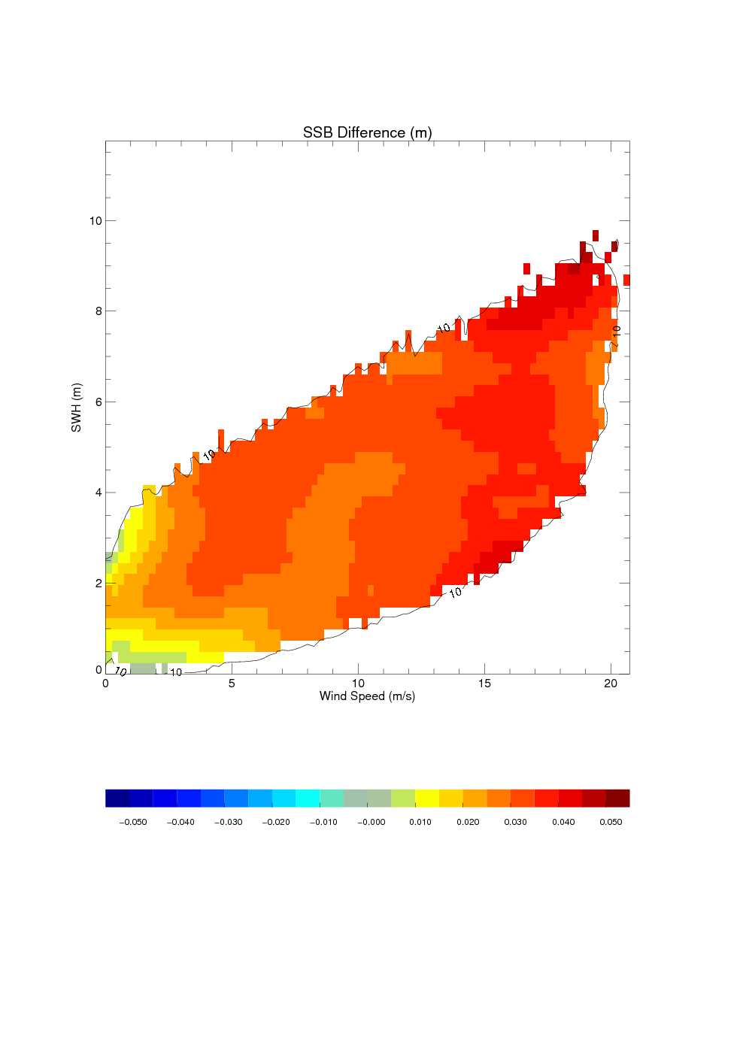
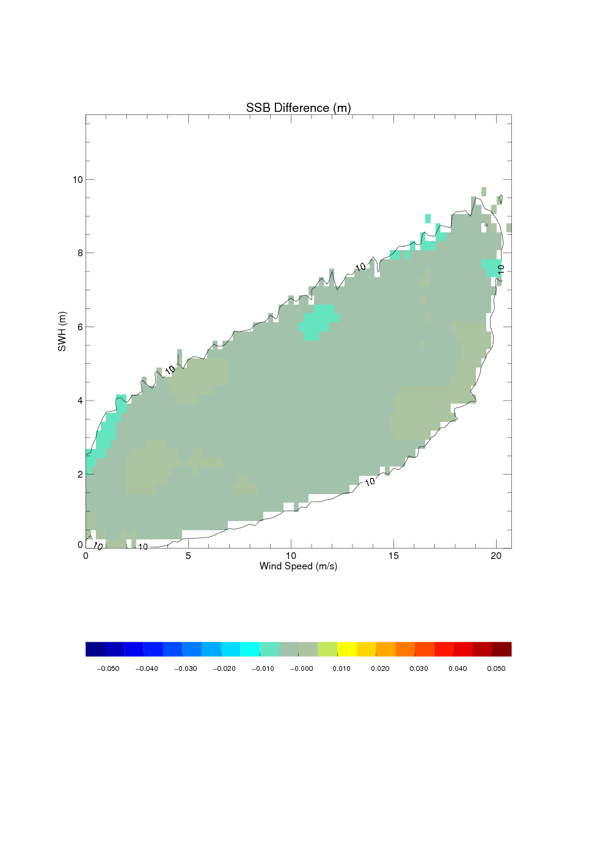
Consistency of SSB models (in term of processing)
Model name | Period (year) | Cycles | Colinear method | Data source | Range & SWH | Wind | Reference
SSB_J1_Ref (operational) | 3 | 1-111 | standard | GDR_B | MLE-4 | MLE-4 | Labroue, 2008
SSB_J1_NewOrb | 3 | 1-111 | modified | GDR_C + GDR_D Orbits | MLE-4 | MLE-4 | Tran, 2012
SSB_J2_Ref (operational) | 1 | 7-43 | modified | GDR_T + GOT4v7 + retracking reprocessed at CLS | MLE-4 | MLE-4 | Tran, 2011
SSB_J2_New | 1 | 1-36 | modified | GDR_D | MLE-4 | MLE-4 | Tran, 2012
SSB_J2_Ref – SSB_J1_Ref
SSB_J2_New – SSB_J1_NewOrb
SSB differences <5 mm between Jason-2 and Jason-1 when solutions are derived from homogeneous datasets and methods. This is expected since the sensors are the same.
[-5, 5 mm]
- 50 mm
+ 50 mm
- 50 mm
+ 50 mm

Slide 14
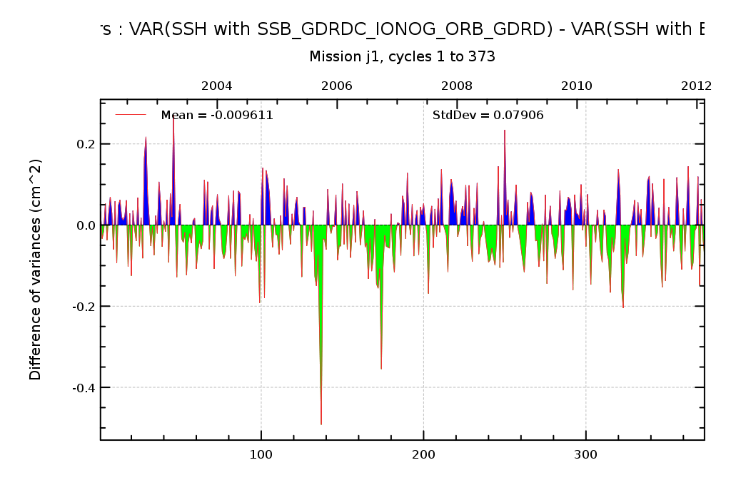
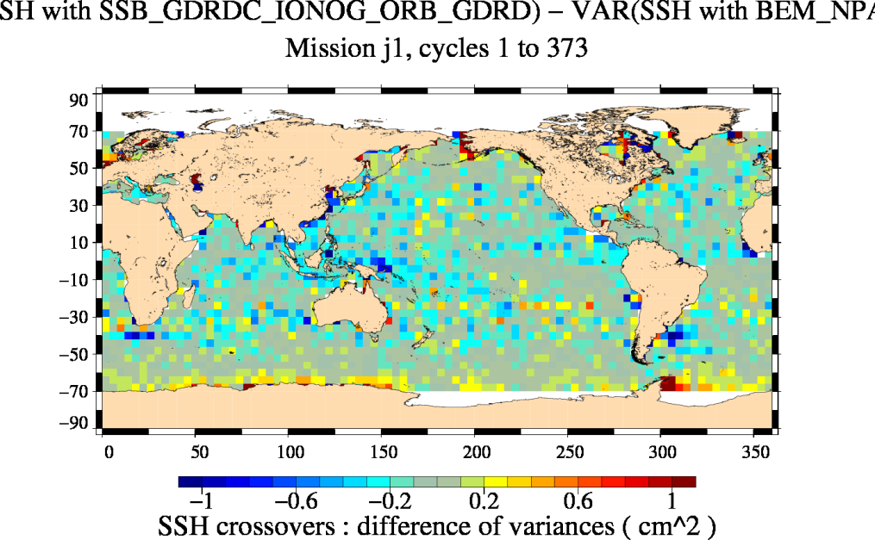
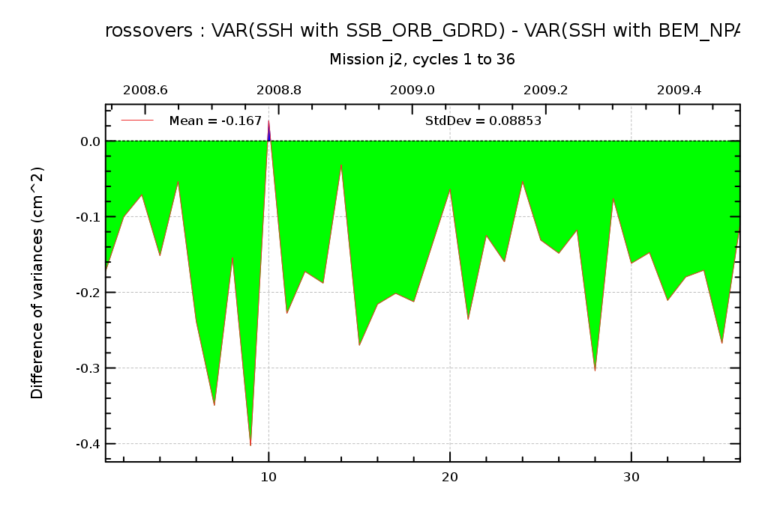
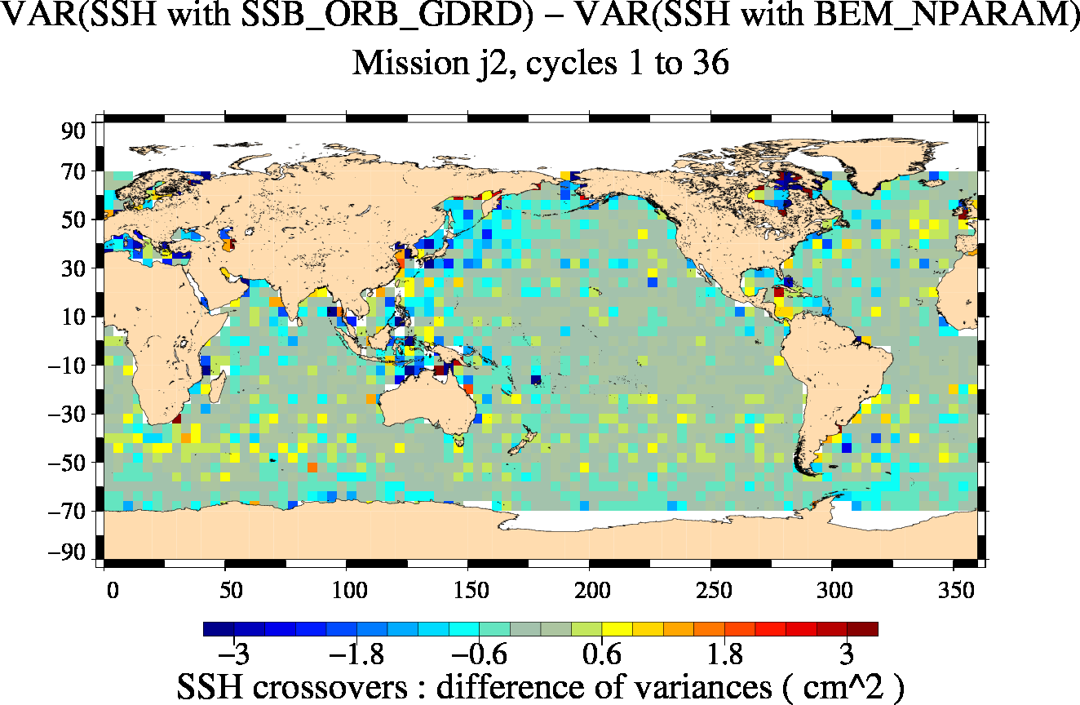
Performance diagnoses
Comparison of SSH variance after applying two different SSB corrections at crossovers.
A reduction of variance for one of them indicates that this SSB performs better than the other
Crossovers: var(SSH)
→ No need to change the SSB model
Crossovers: var(SSH)
→ Better to update the SSB model,
some improvement observed

Slide 15
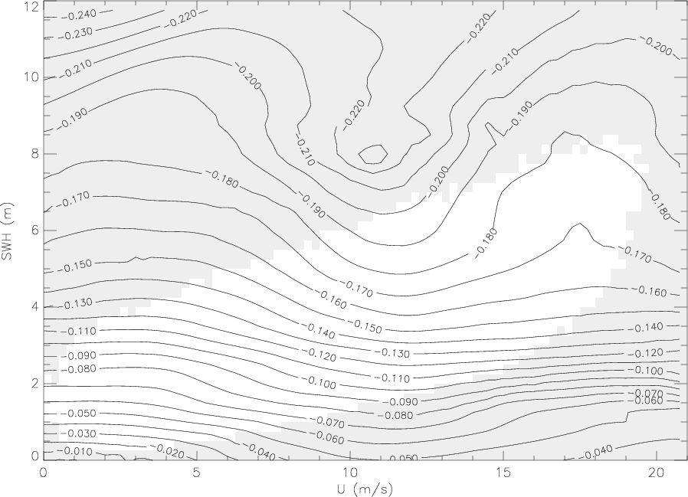
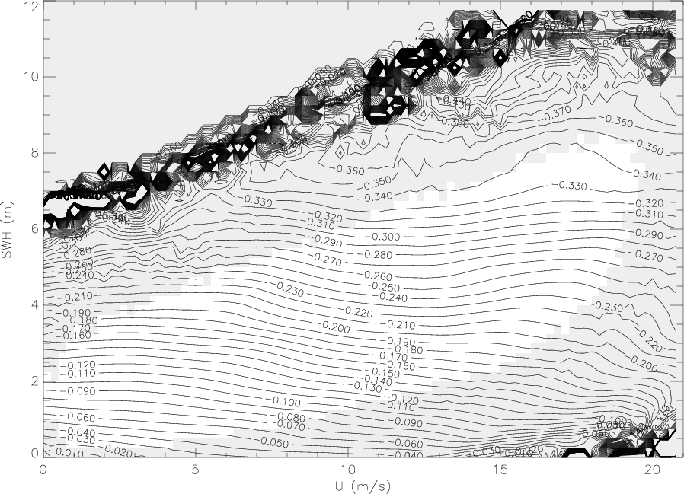
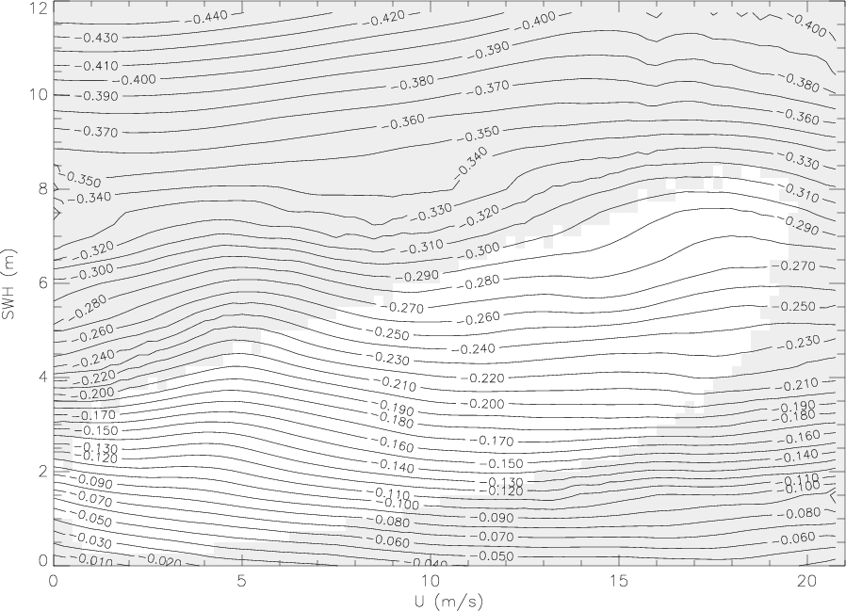
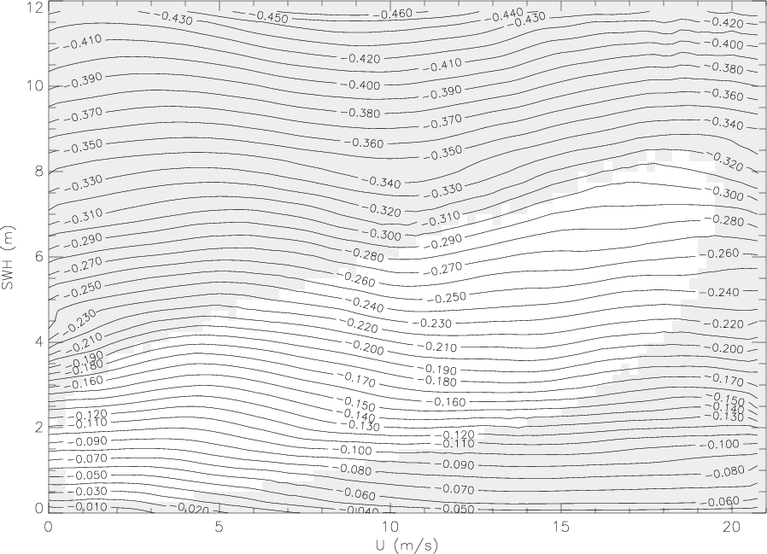
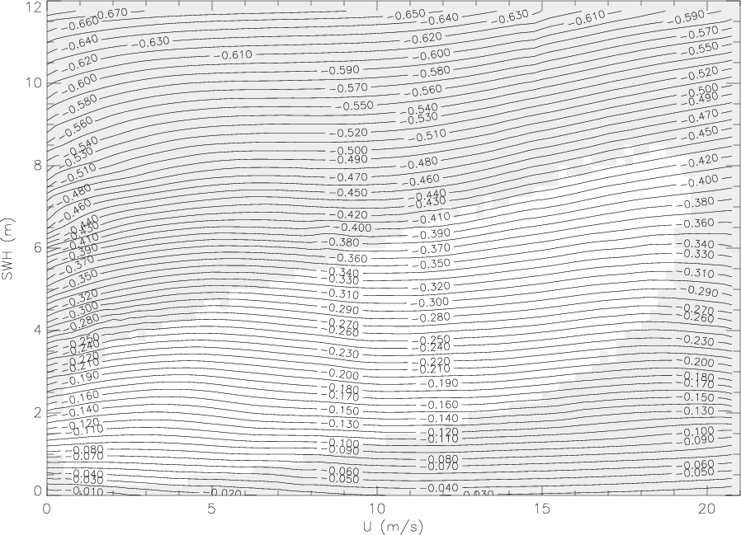
Mission specific models (NP versions)
Topex A
Topex B
GFO
15 cm
18 cm
34 cm
Jason-1
EnviSat
ERS2
30 cm
30 cm
42 cm

Slide 16
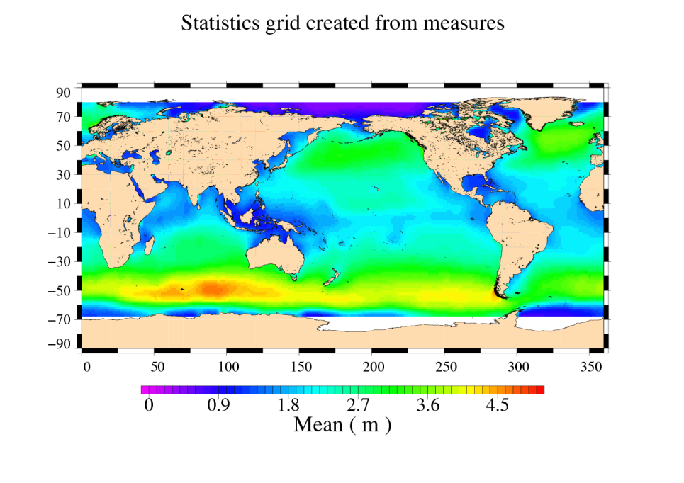
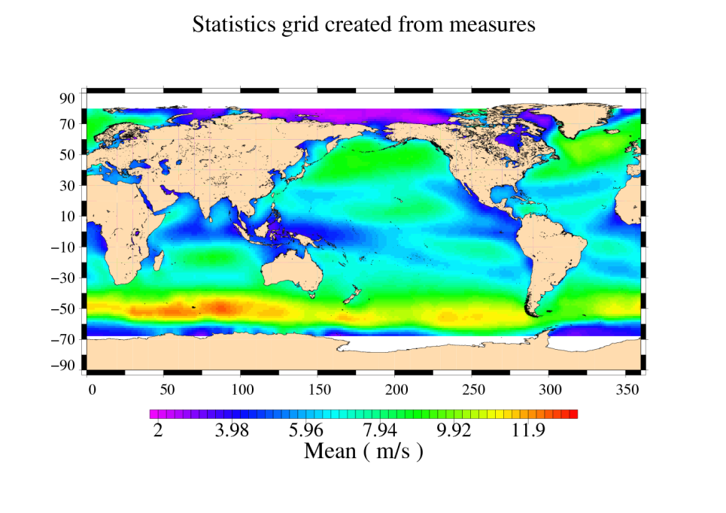
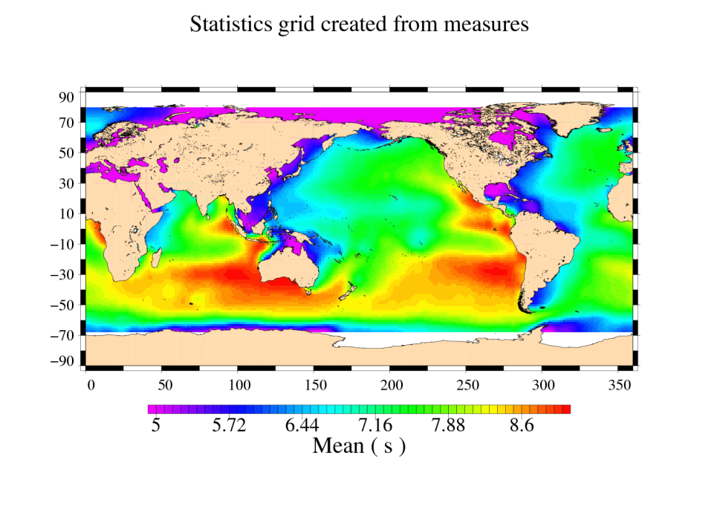
3D SSB (SWH, Wind speed, wave period)
Development of 3D SSB (SWH, Ualt, Tm) to better model SSB behavior with improved description of the sea state.
Tm : mean wave period from a numerical wave model (WAVEWATCH-III, used operationally at NOAA/NCEP)
SWH
Wind speed
Tm

Slide 17
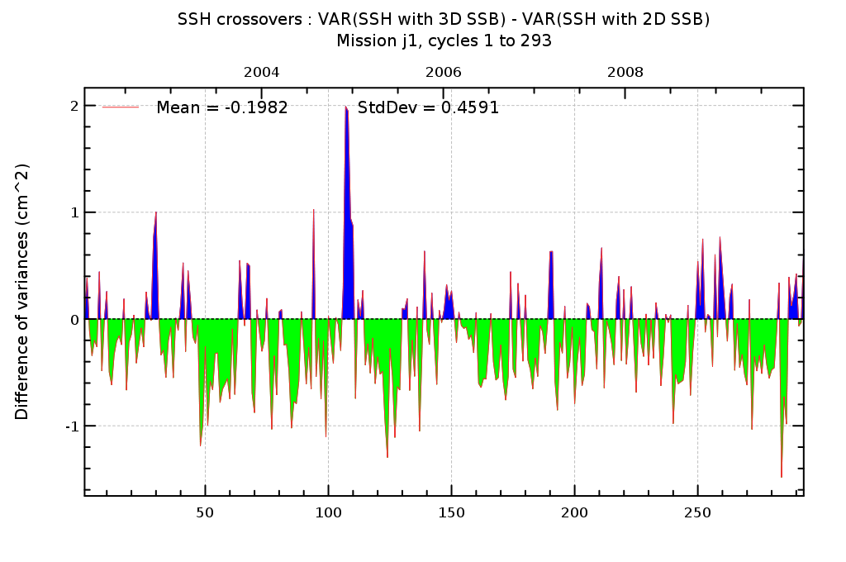
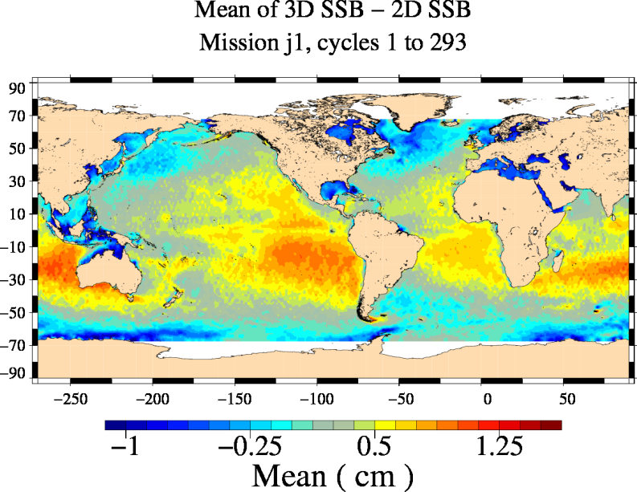
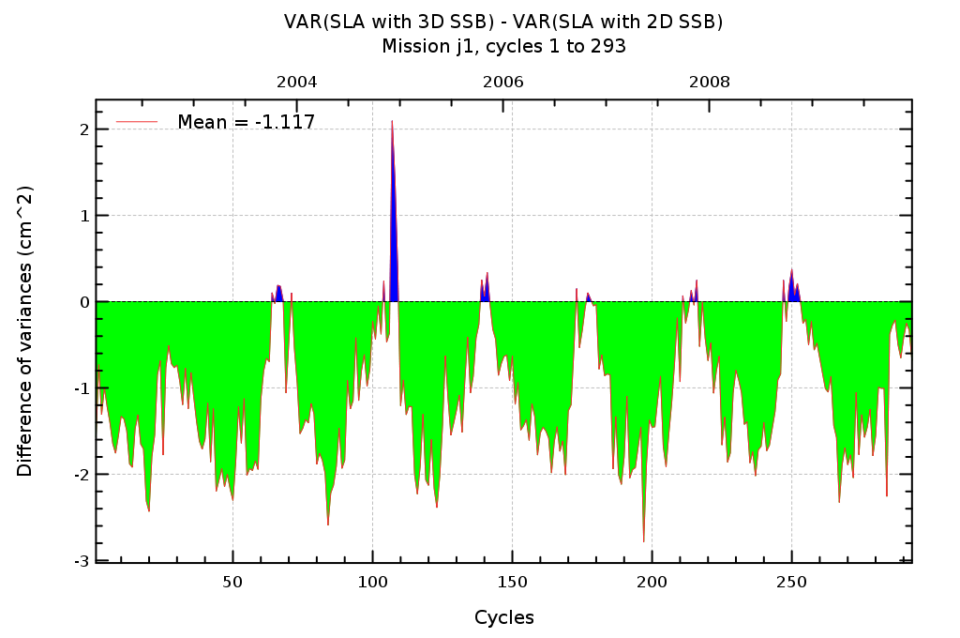
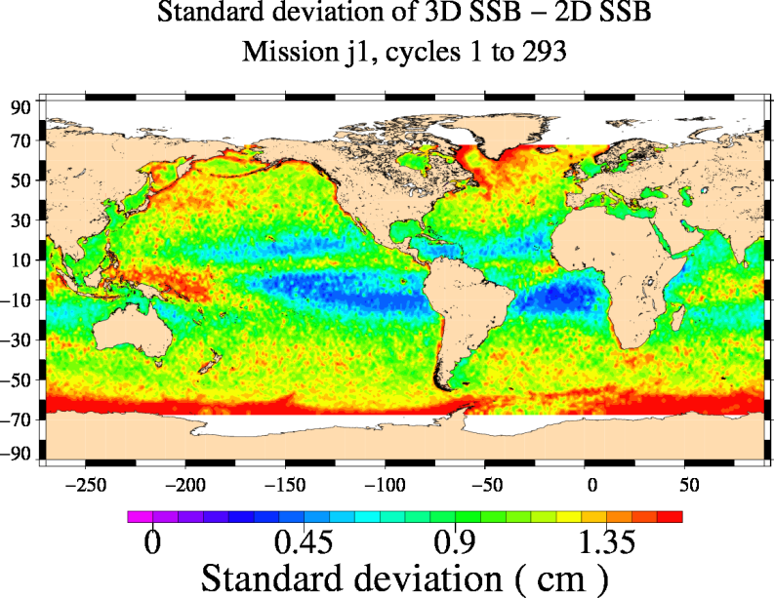
3D SSB vs operational 2D SSB
2
-0.20 cm²
-1
Crossovers: var(SSH)
2
-1.12 cm²
-2
Along-track: var(SLA)
→ Patterns show differences in SSB behavior description
→ A reduction of variance for the 3D model indicates that it performs better than the 2D one

Slide 18
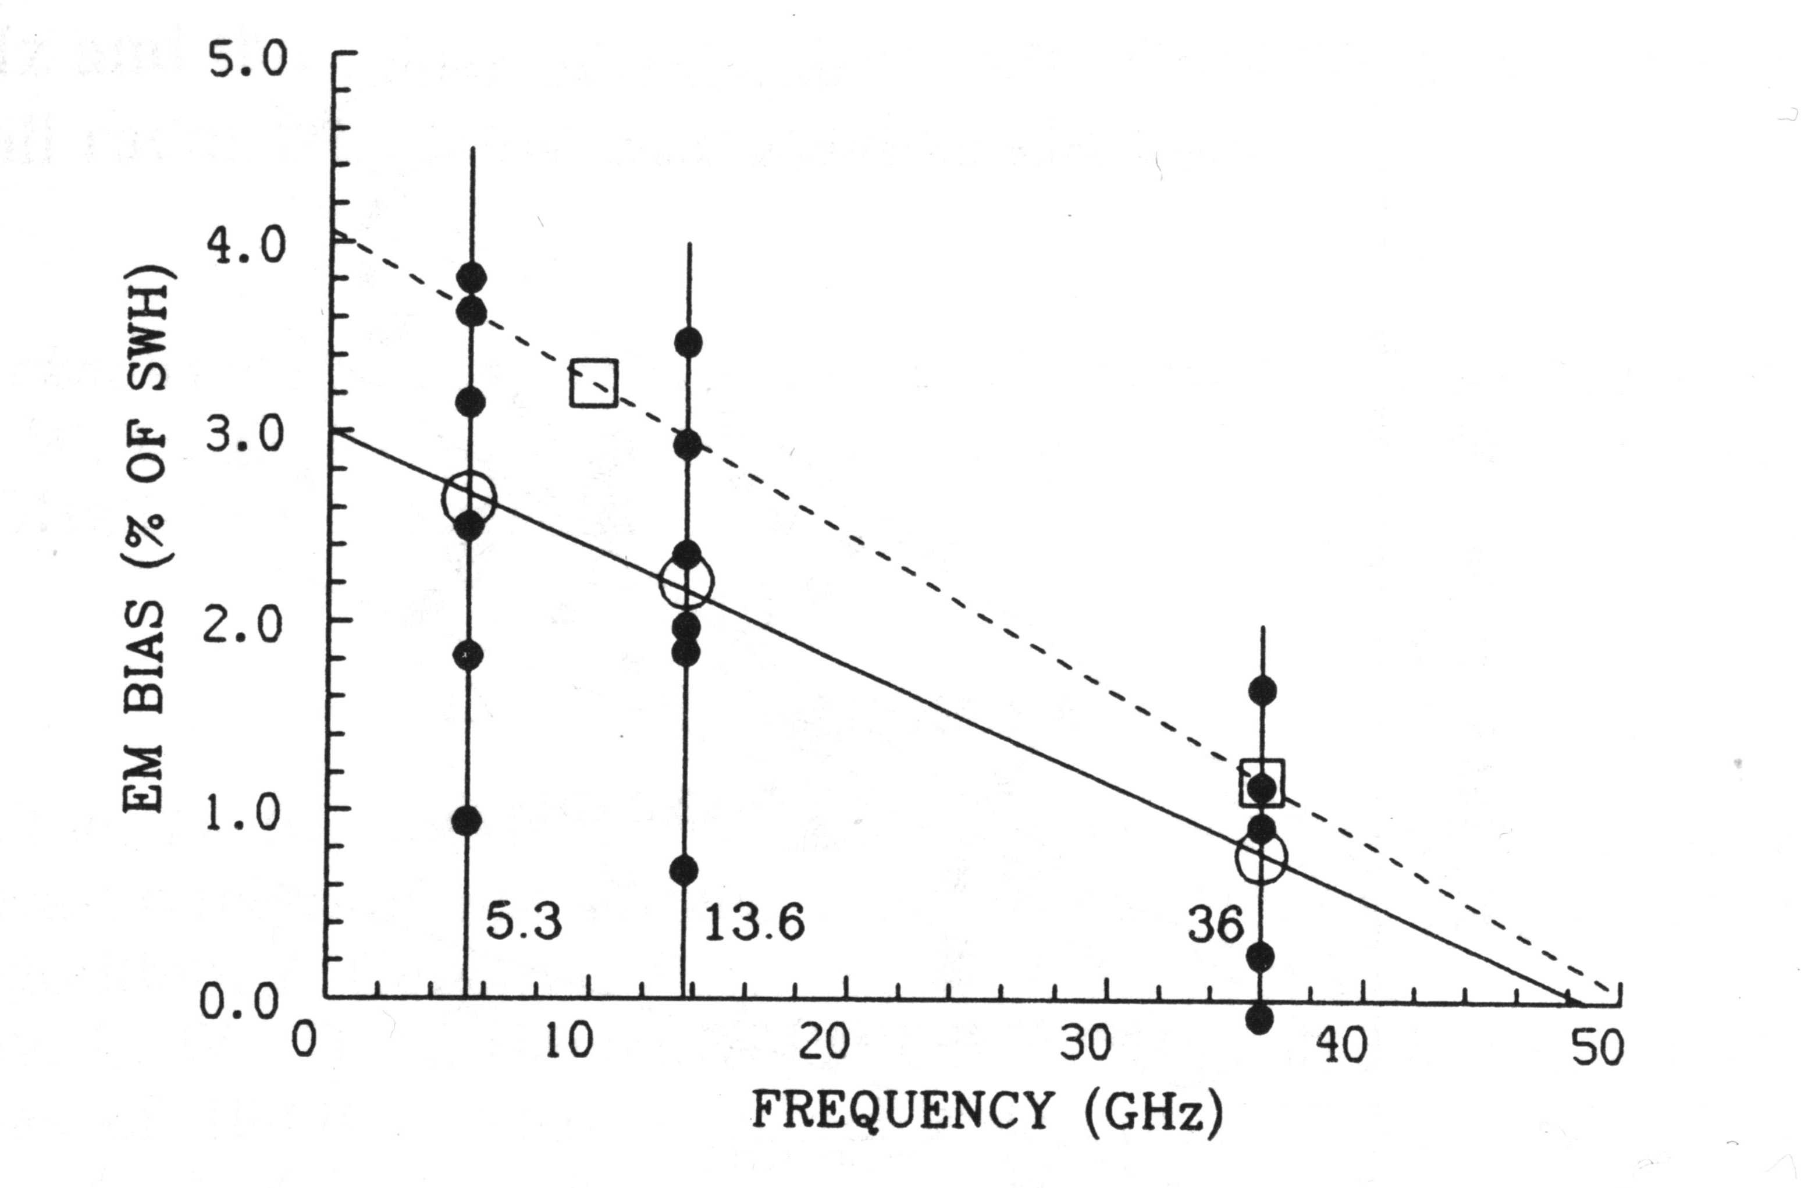
Radar frequency dependence
Tower and airborne measurements
C, X, Ku, Ka band
EMB error is larger at low frequency
From Walsh (1991)

Slide 19
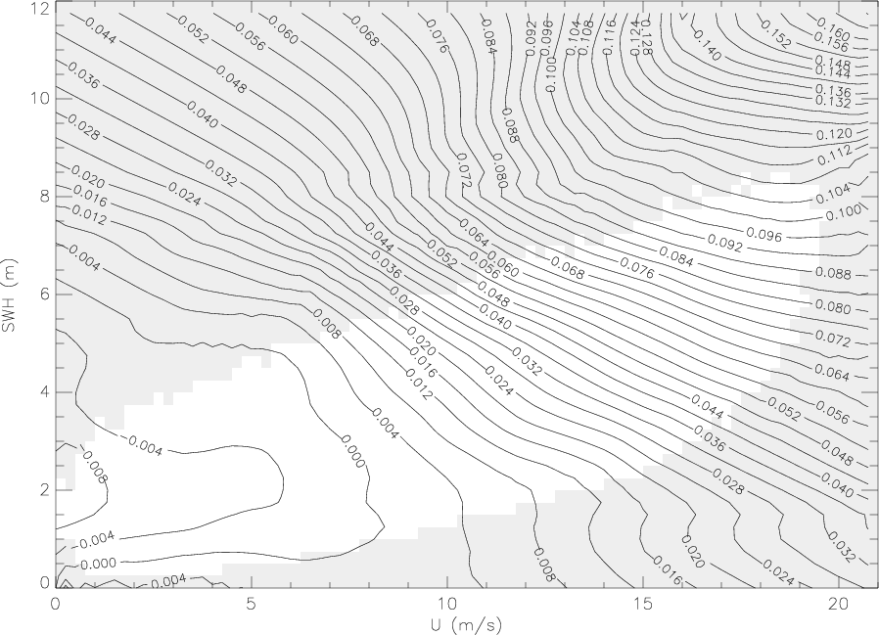
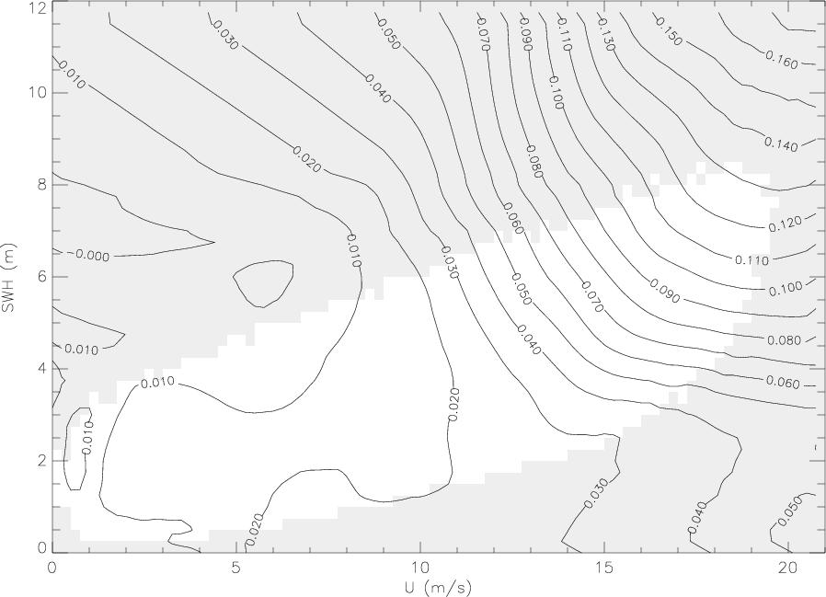
Radar frequency dependence
Satellites measurements:
S, C, Ku-band
variation with sea state
10 cm
13 cm
(Ku-band – C-band) SSB, Jason-1
(Ku-band– S-band) SSB, EnviSat

Slide 20
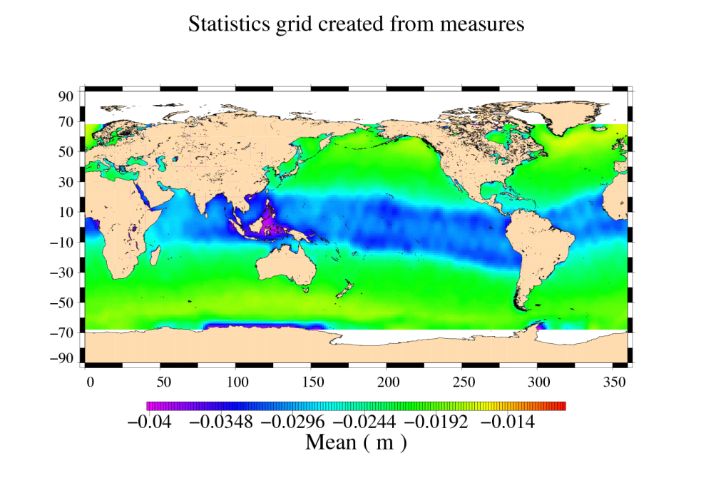
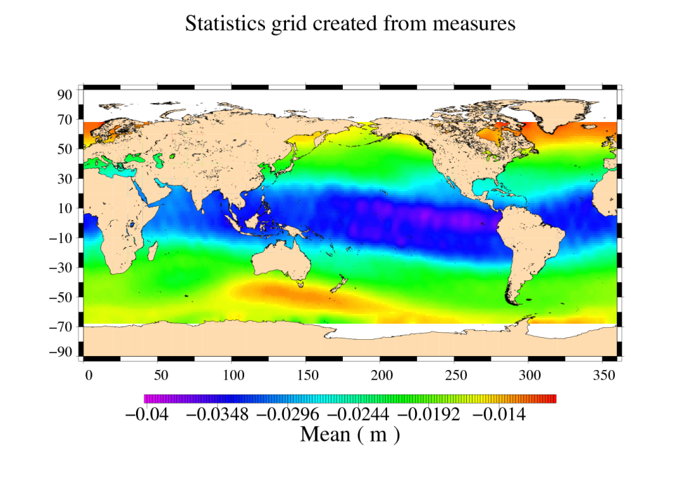
Dual-frequency ionospheric correction (another correction necessary for accurate Ku-band SSH)
Iono_ku = δf_{ku} [ (R_{c} – SSB_{c}) – (R_{ku} – SSB_{ku}) ]
δf_{ku}= f_{c}² / ( f_{ku}² - f_{c}²) ~ 0.179 for Topex, Jason missions
(~ 0.059 for Envisat / S-band)
Jason-2, Dual_Iono
Jason-2, Gim_Iono (from GPS data)

Slide 21
To go further: some references
Amarouche, L., « Contribution à l’étude du biais d’état de mer », Thèse de doctorat, Paris 7, Paris, 2001.
Dubois, P. 2011. “Impact de l’état de mer sur la mesure d’élévation des futurs instruments altimétriques ”, thèse de doctorat de l'Université Paul Sabatier, Toulouse, France.
Fu, L-L. and Cazanave, A. 2001. “Satellite altimetry and earth sciences. A handbook of techniques and applications”. San Diego: Academic Press. 463pp.
Gaspar, P., S. Labroue, F. Ogor, G. Lafitte, L. Marchal, and M. Rafanel. 2002. « Improving nonparametric estimates of the sea state bias in radar altimetry measurements of sea level », J. Atmos. Oceanic Technol., 19, 1690-1707.
Labroue, S., P. Gaspar, J. Dorandeu, F. Mertz, N. Tran, O.-Z. Zanife, P. Vincent, N. Picot, and P. Femenias. 2006. “Overview of the improvements made on the empirical determination of the sea state bias correction », Proceedings of the of the 15 Years of Progress in Radar Altimetry Symposium, Venice, Italy, 13-18 March 2006. (Available at http://earth.esa.int/workshops/venice06/participants/318/paper_318_labroue.pdf).
Tran, N., D. Vandemark, S. Labroue, H. Feng, B. Chapron, H. L. Tolman, J. Lambin, and N. Picot: “Sea state bias in altimeter sea level estimates determined by combining wave model and satellite data”, J. Geophys. Res., 115, C03020, doi:10.1029/2009JC005534, 2010.
Vandemark, D., N. Tran, B. D. Beckley, B. Chapron, and P. Gaspar. 2002. Direct estimation of sea state impacts on radar altimeter sea level measurements. Geophys. Res. Lett., 29(24), 2148. doi:10.1029/2002GL015776.
Walsh, E. J. , F. C. Jackson, D. E. Hines, C. Piazza, L. G. Hevizi, D. J. Mclaughlin, R. E. Mcintosh, R. N. Swift, J. F. Scott, J. K. Yungel, and E. B. Frederick, "Frequency dependence of electromagnetic bias in radar altimeter sea surface range measurements" , Journal of Geophysical Research, vol. 96, no. Cll, pp. 20571-20583, 1991.

